Slide 1
Credit Card Fraud Detection using Spark and H2O
Ramakrishna Mission Vivekananda Educational and Research Institute
B2530087 : Sayan Ghosh
B2530096 : Pritam Kayal
B2530079 : Niladri Banerjee

Slide 2
Problem Statement
Credit card fraud is a major financial threat worldwide
Fraud transactions are very rare (~0.17%) → highly imbalanced data
Traditional detection systems fail on large-scale data
Need for scalable and intelligent fraud detection system

Slide 3
Dataset Overview
Source : Creditcard.csv(https://www.kaggle.com/datasets/mlg-ulb/creditcardfraud)
Total Records: 284,807
Total Features: 31 columns.
Dataset Type: Binary classification (Fraud Detection)
Dataset is highly imbalanced
Target column:
0 → Normal
1 → Fraud

Slide 4
Data Preprocessing
Handled class imbalance (undersampling / weighting)
Split dataset into training and testing sets
Cached data using df.persist() for efficiency
Used Spark for:
Data distribution
Parallel processing

Slide 5
Why Spark + H2O
Spark:
Distributed data processing
Handles large datasets efficiently
H2O:
Distributed machine learning framework
Optimized algorithms
Sparkling Water:
Integration of Spark + H2O

Slide 6
Architecture Explanation
Spark reads CSV dataset
Data is partitioned across cluster nodes
DataFrame converted to H2OFrame
H2O trains Random Forest model
Model generates predictions
Results converted back to Spark DataFrame
Output saved

Slide 7
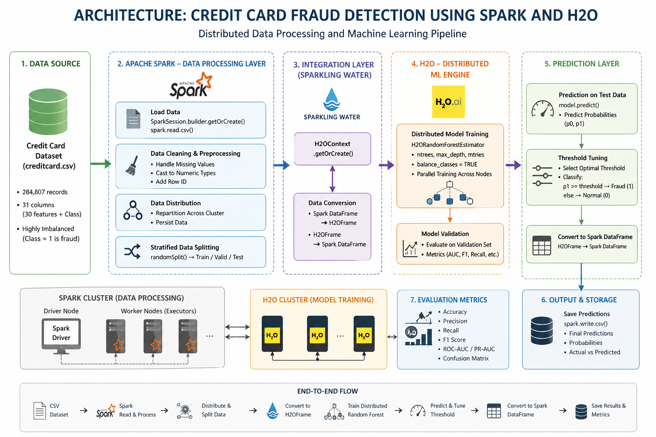
Architecture

Slide 8
Model Explanation
Ensemble learning method
Uses multiple decision trees
Final prediction based on majority voting
Why Random Forest?
Handles large datasets
Works well with imbalanced data
Reduces overfitting

Slide 9
Evaluation Metrics
Precision → How many detected frauds are correct
Recall → How many actual frauds are detected
F1-score → Balance between precision & recall
ROC-AUC → Overall model performance

Slide 10
Spark Framework calls :
SparkSession.builder.getOrCreate()
Spark.read.csv()
df.repartition()
df.persist()
df.randomSpilt()
write.csv()

Slide 11
H2O Framework calls :
H2OContext.getOrCreate()
Hc.asH2OFrame()
H2ORandomForestEstimators()
model.train()
model.model_performance()
model.predict()
hc.asSparkFrame()
h2o.save_model()

Slide 12
Framework :
Spark starts → Spark reads Csv → Spark repartitons and split data across workers → HOContext connect Spark with H2O → Spark dataFrame transforms into H2OFrame → H2O trains distributed Random Forest → H2O predicts on train data → H2OFrame transforms into Spark dataFrame → Spark writes final output files

